Slide 1
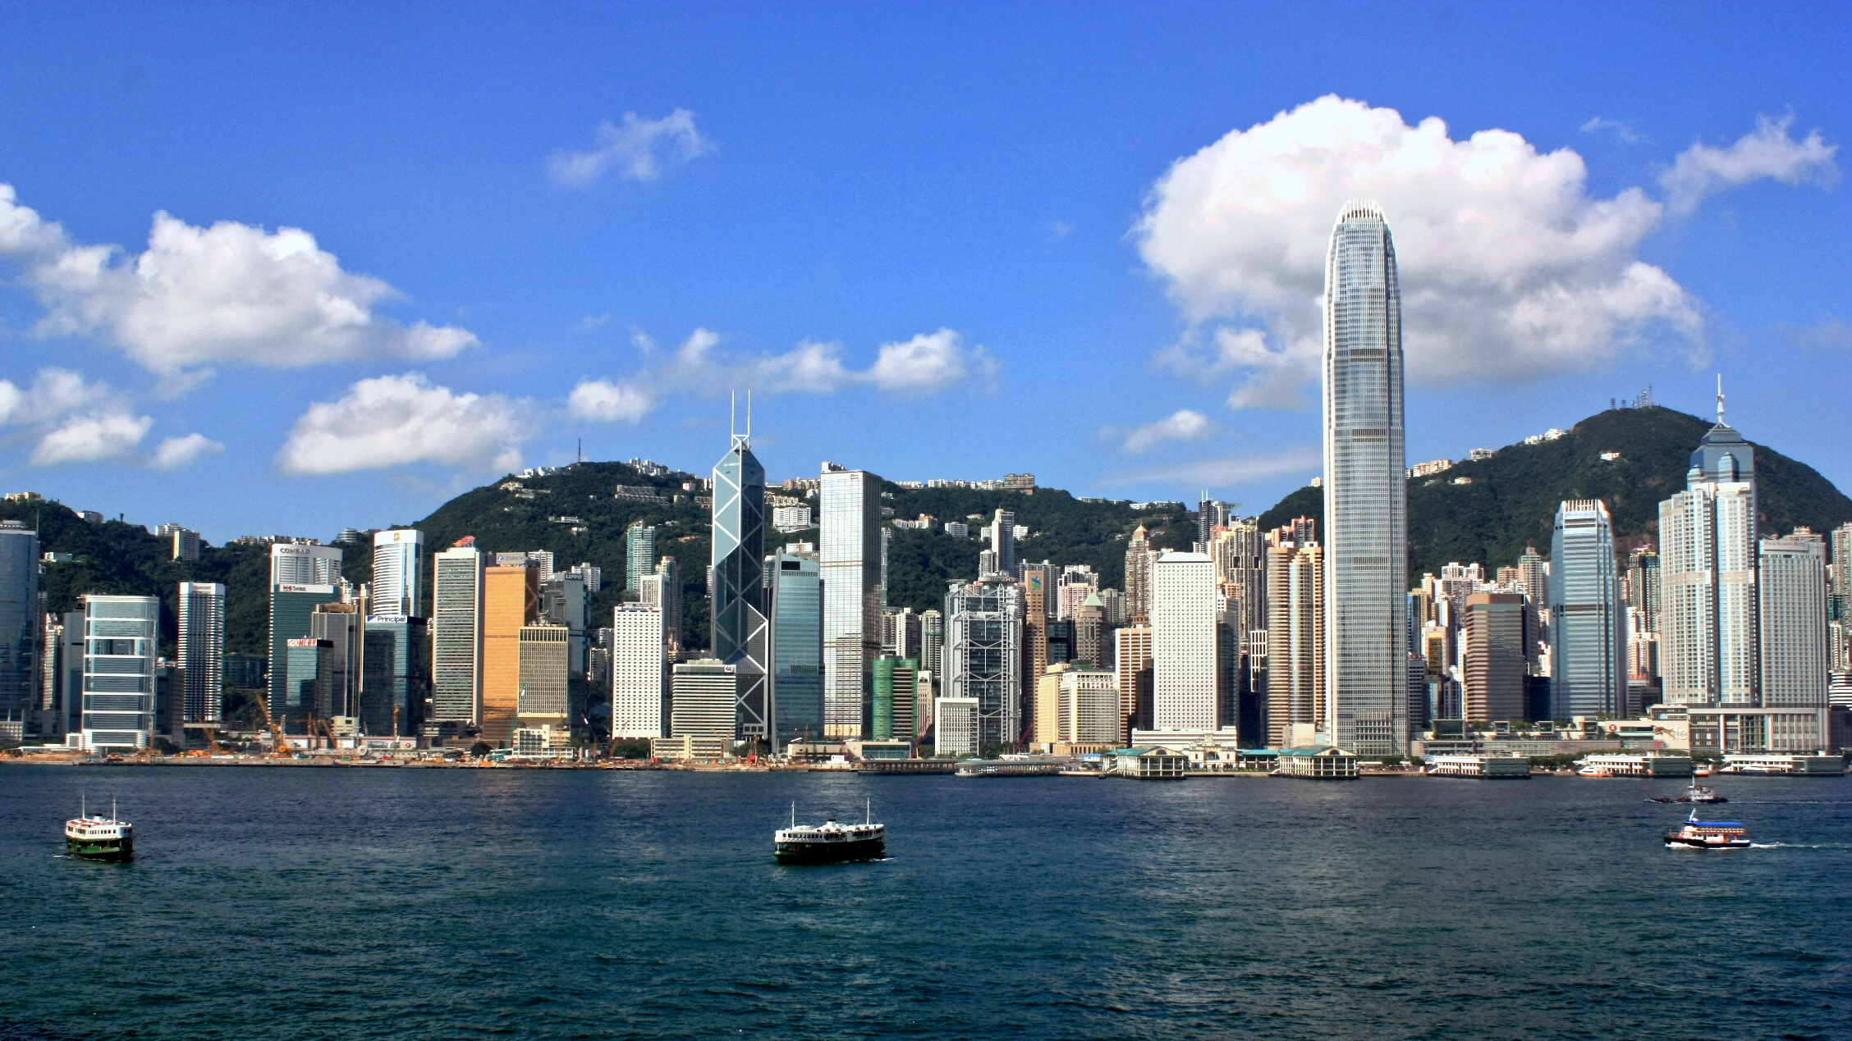


A Multidimensional AI-powered Framework for Analyzing Tourist Perception in Historic Urban Quarters: A Case Study in Shanghai
Kaizhen Tan 谭楷蓁
School of Economics and Management
Tongji University
In collaboration with: Yufan Wu, Yuxuan Liu, Haoran Zeng
Supervisor: Dr. Yujia Zhai

Slide 2
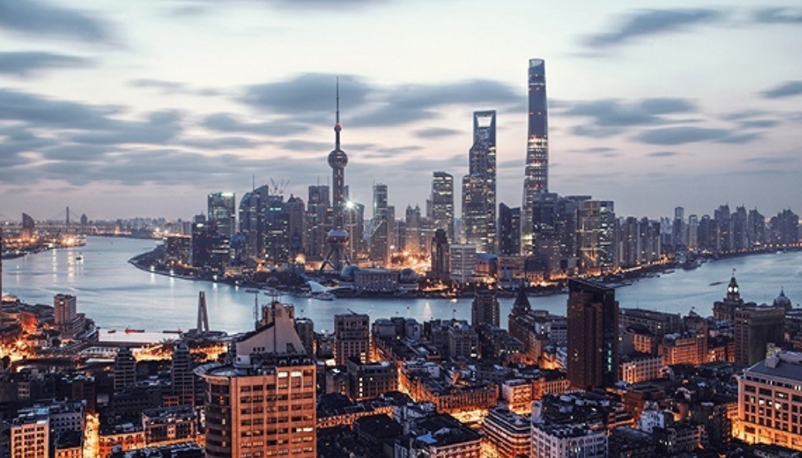
01
Introduction
02
Methodology
Content
03
04
Results
Discussion
05
Conclusion

Slide 3
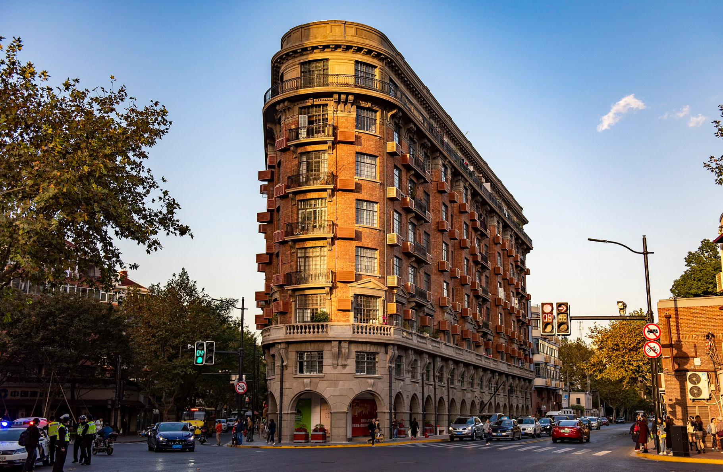
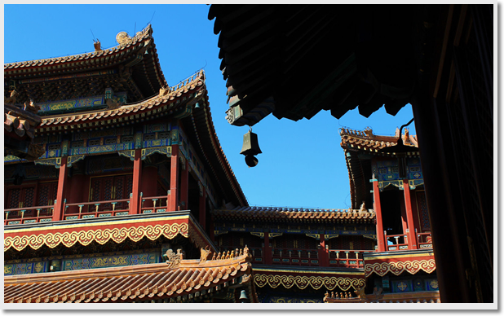
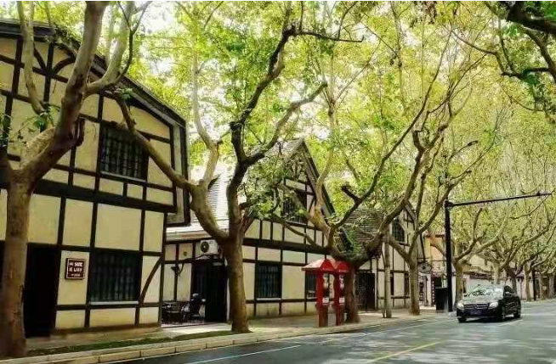
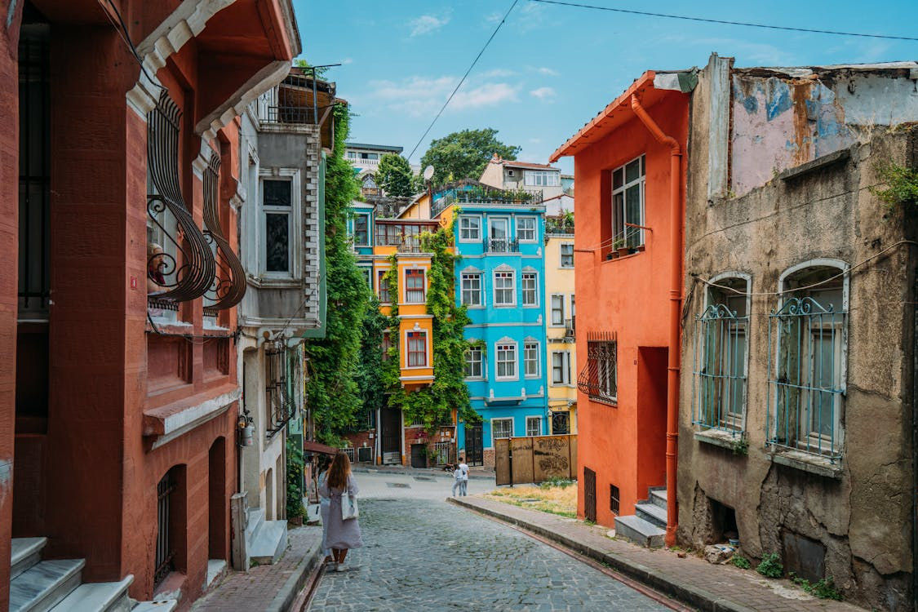
1、Introduction
Historic urban quarters are not only physical spaces but also the embodiments of cultural heritage, bearing a city’s collective memory and distinct local identity.
As these quarters experience growing tourist attention and urban change, it becomes increasingly important to understand how they are perceived, not only emotionally,
but also aesthetically.
Traditional methods like surveys often fall short in capturing real-time, large-scale insights. Meanwhile, the rise of user-generated content and advances in AI open new opportunities to decode tourist perception through visual and textual data.

Slide 4
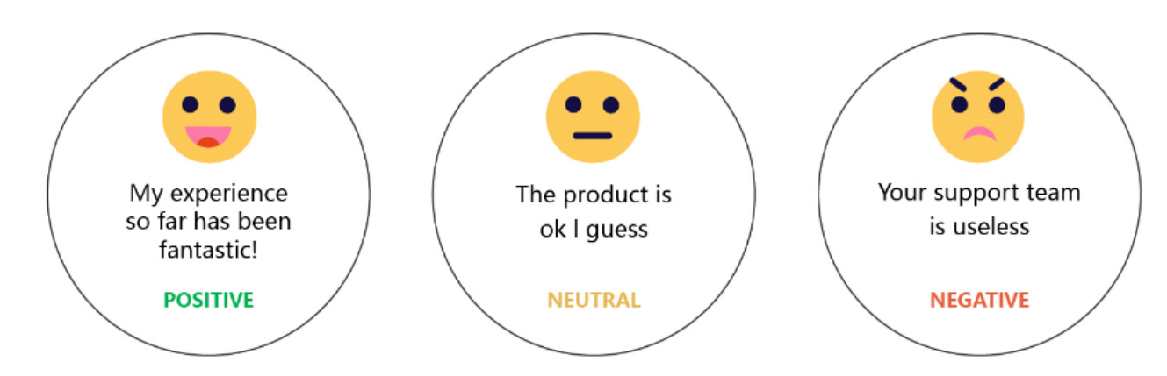
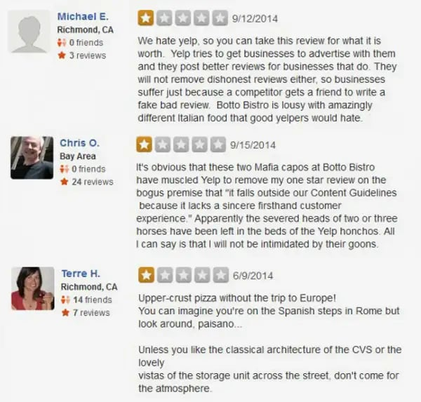
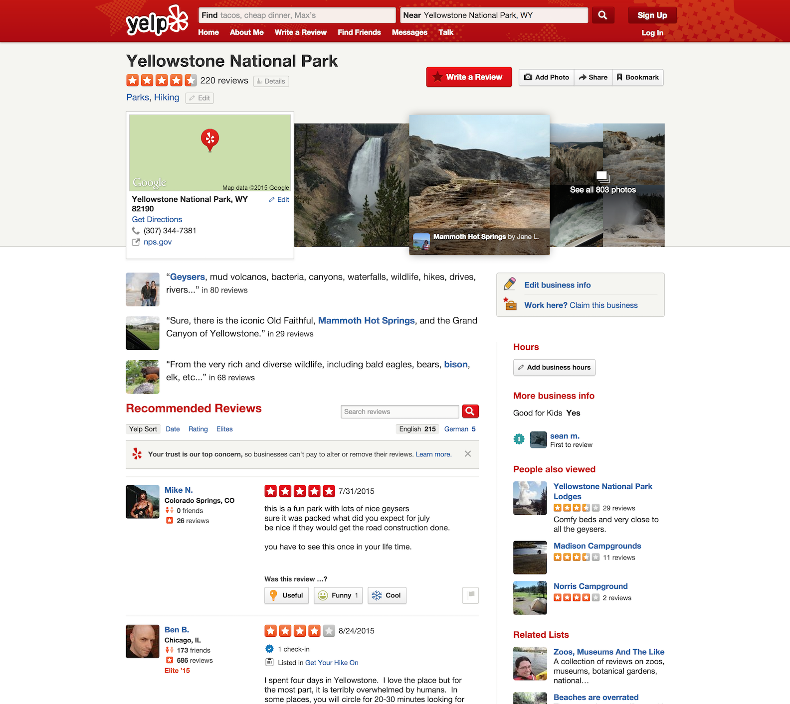
1、Introduction
How do we extract the emotional response of tourists?
This part is relatively straightforward—people leave online reviews, and it’s often clear whether they feel positive or negative about their experience. Sentiment analysis is a pretty mature research domain, whether using rule-based methods or deep learning models.
positive
negative

Slide 5
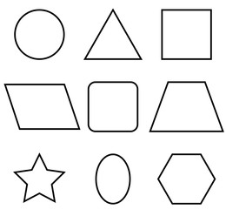
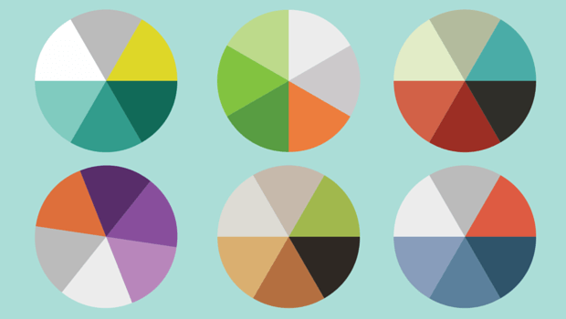
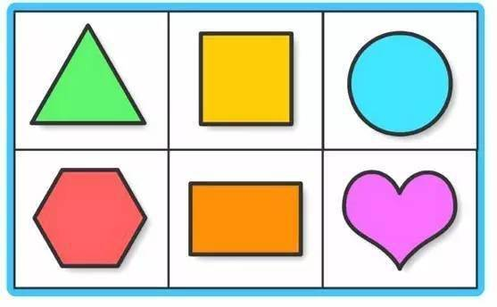
1、Introduction
But the real challenge lies in capturing something more complex: aesthetic response.
Aesthetics represent a higher-level cognitive function of human being.
What makes our brain decide that something is beautiful?
If we break down any picture, regardless of its subject matter, it essentially consists of two visual components: colors and forms (such as lines and contours). Since form is difficult to quantify in a consistent and objective way, our analysis focuses on color, which serves as one of the primary subjects of this study.

Slide 6
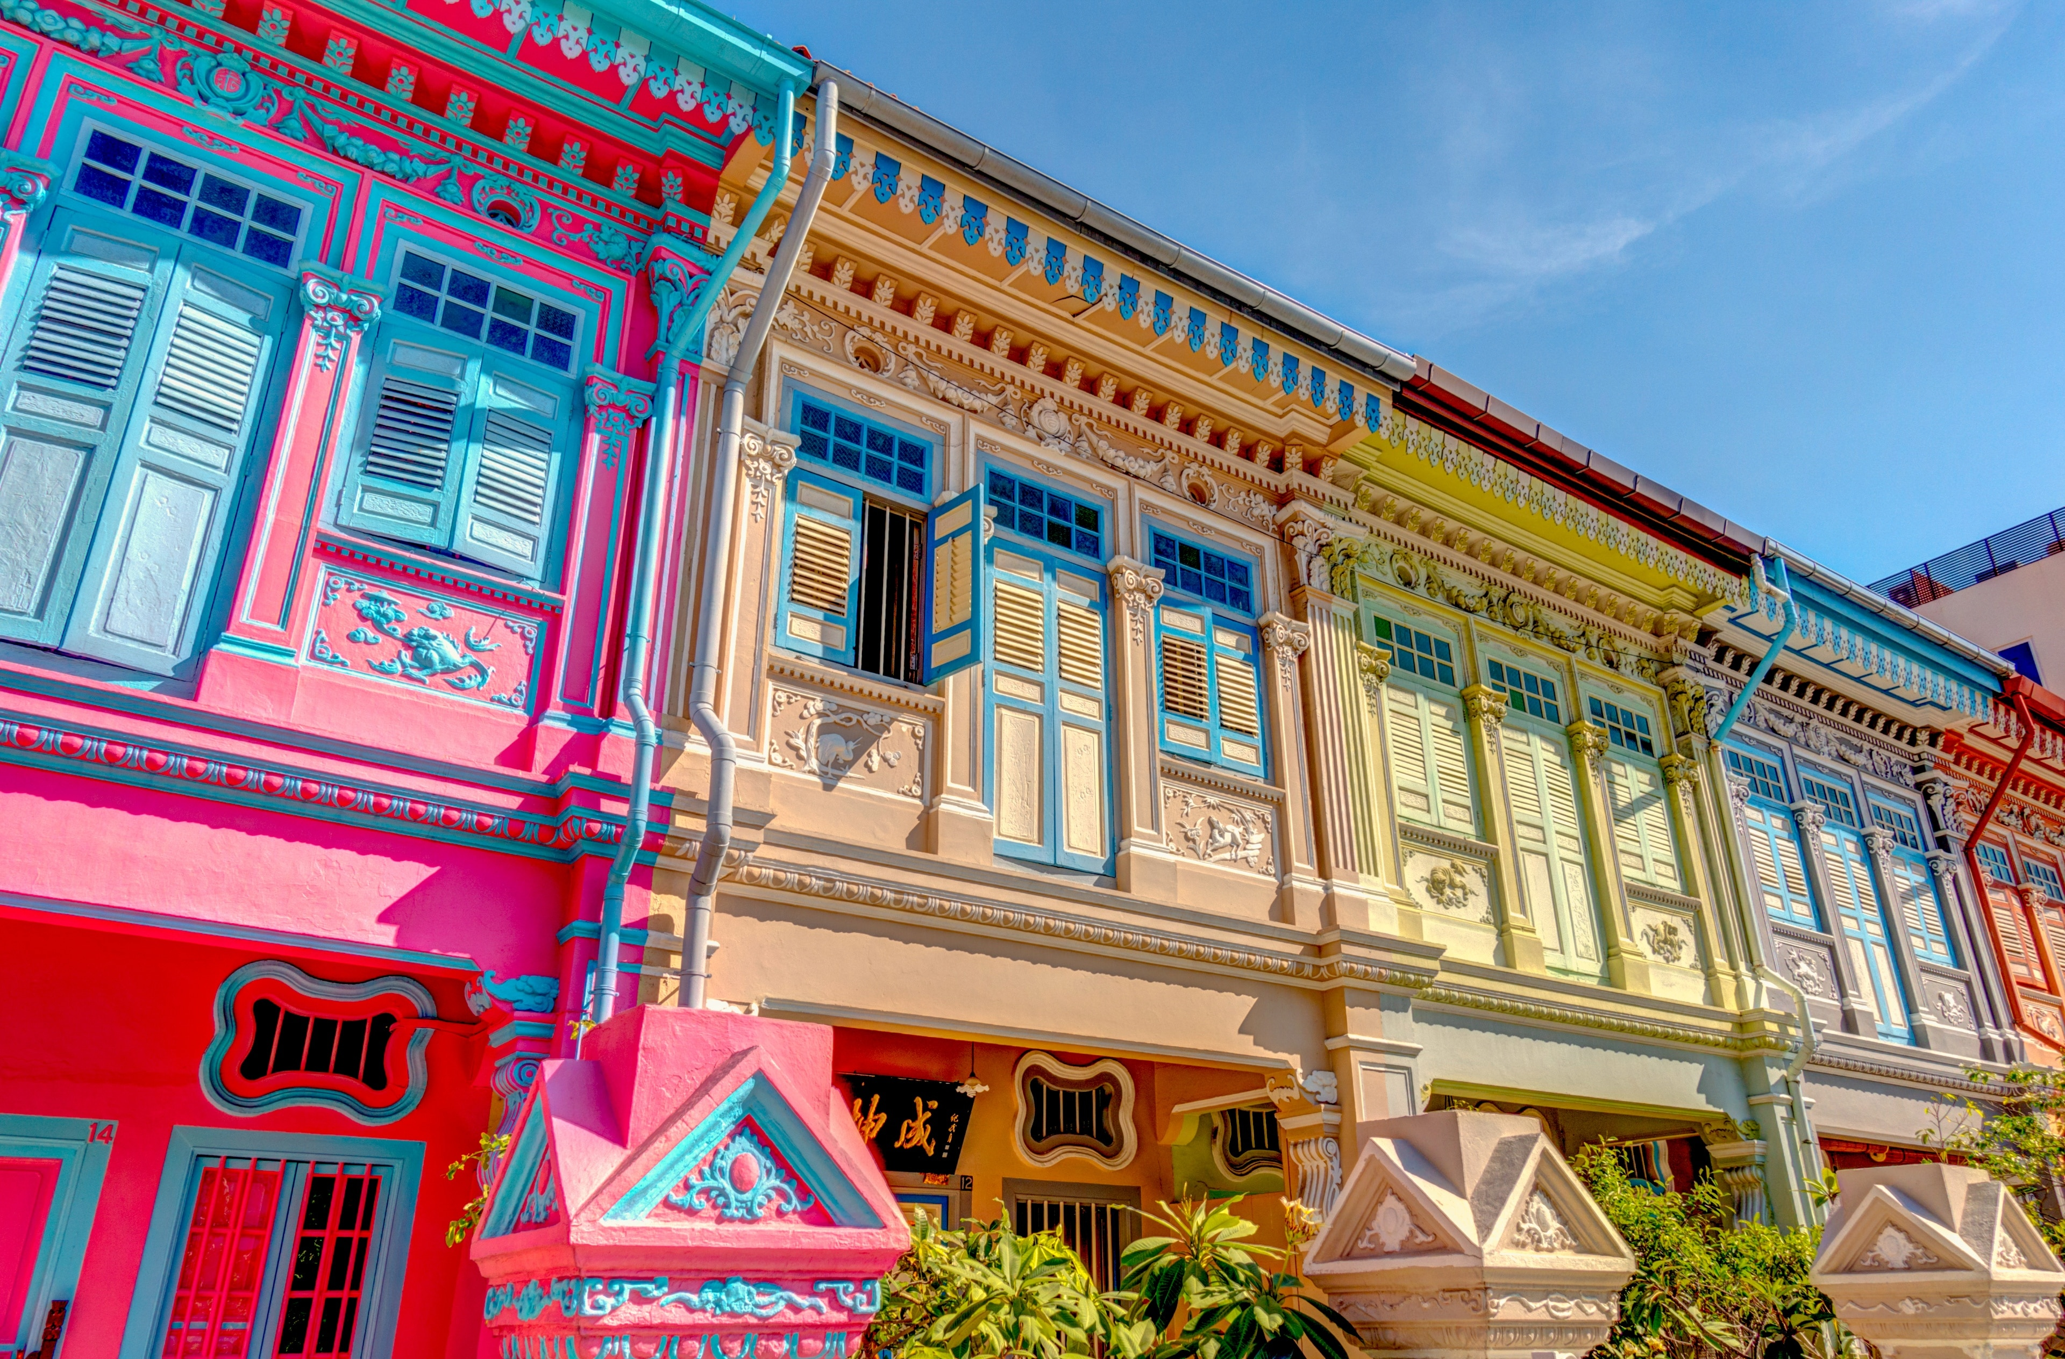
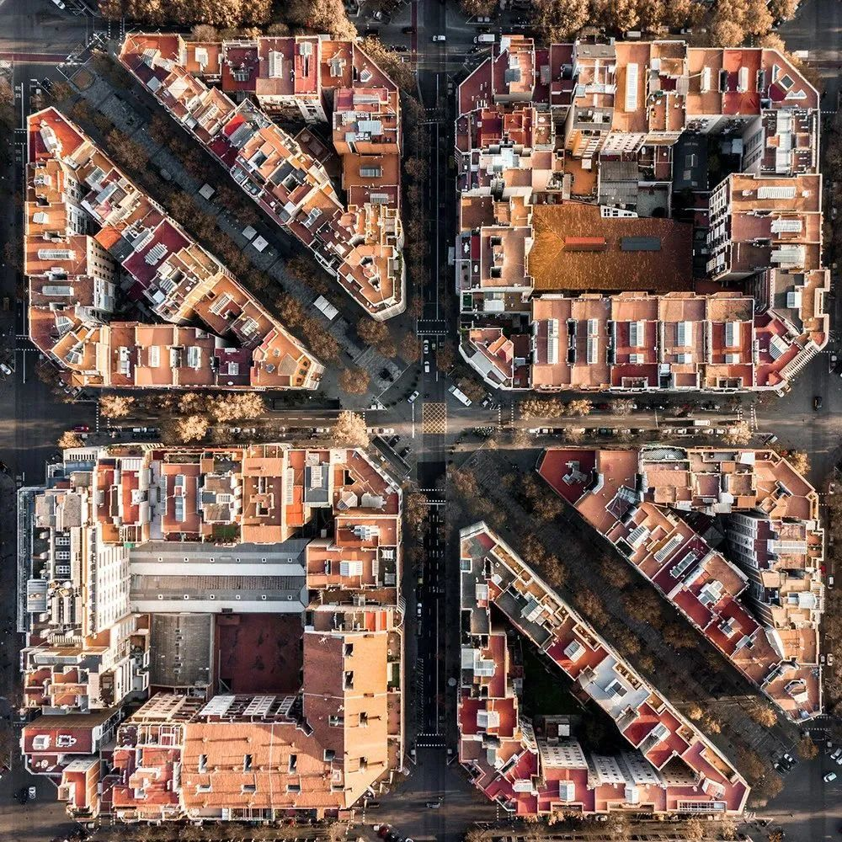
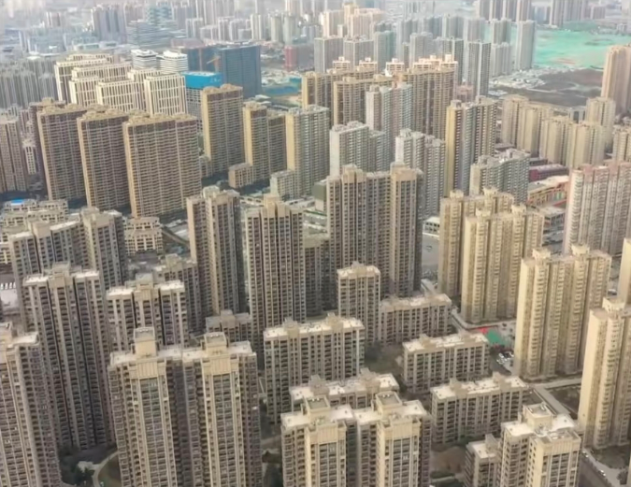
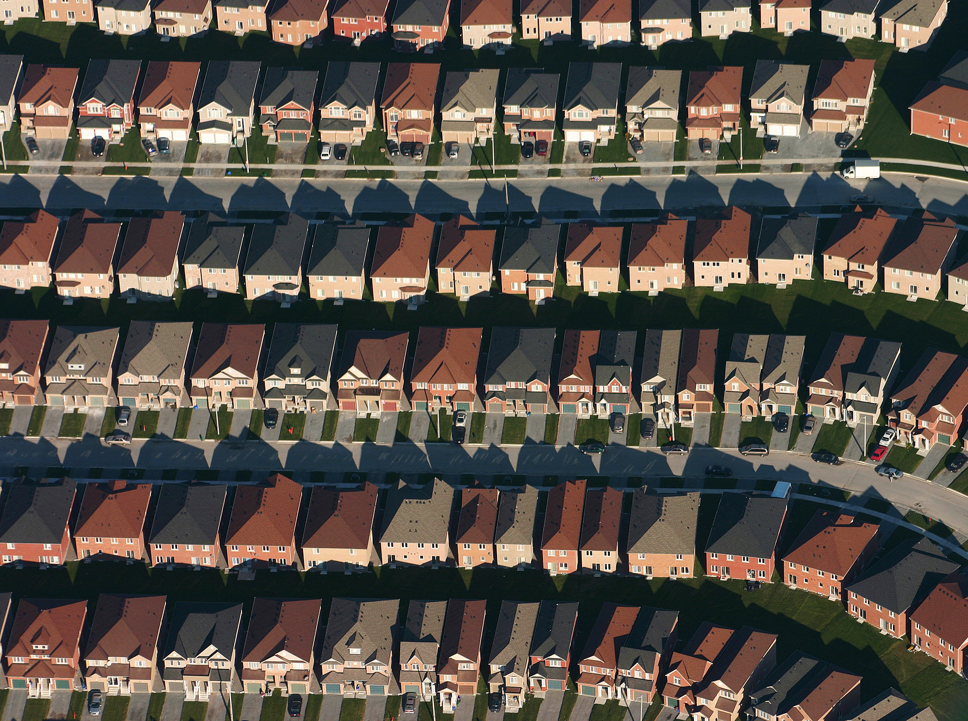
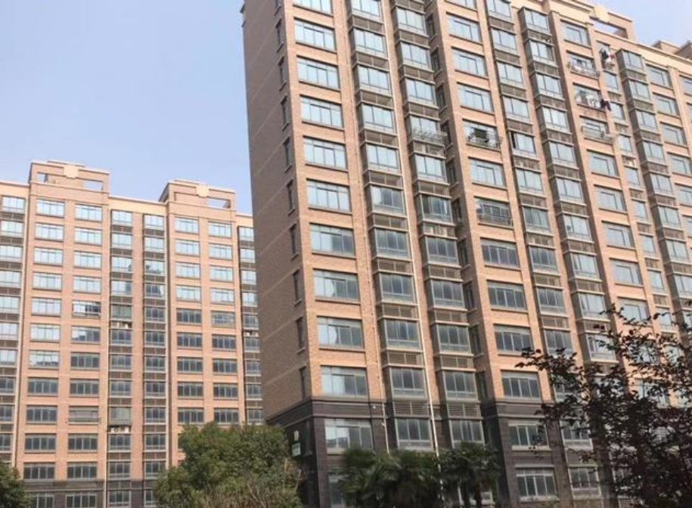
1、Introduction
An experiment——Which one looks the most beautiful to you?
Most people can agree on the least appealing one.
When it comes to the “most beautiful,” opinions often diverge.

Slide 7

1、Introduction
This leads to a paradox:
on one hand, we want to construct a cognitive model of beauty to guide urban design.
on the other hand, maybe there can never be a single universal metric for beauty.
“There Are a Thousand Hamlets in a Thousand Readers' Minds.”
Some existing studies use color complexity,
but more colors doesn’t always mean more beauty. Simplicity can also be elegant.
Others use color harmony,
but that is subjective and lacks a unified computational formula.
So here’s our proposition: even if we don’t know exactly which one is more beautiful, we believe that people share underlying preferences—a kind of collective aesthetic logic.
We need a more objective index to measure the commonalities and differences between different forms of beauty, so as to inform the direction of urban design. In this study, we choose color distribution as that index.

Slide 8
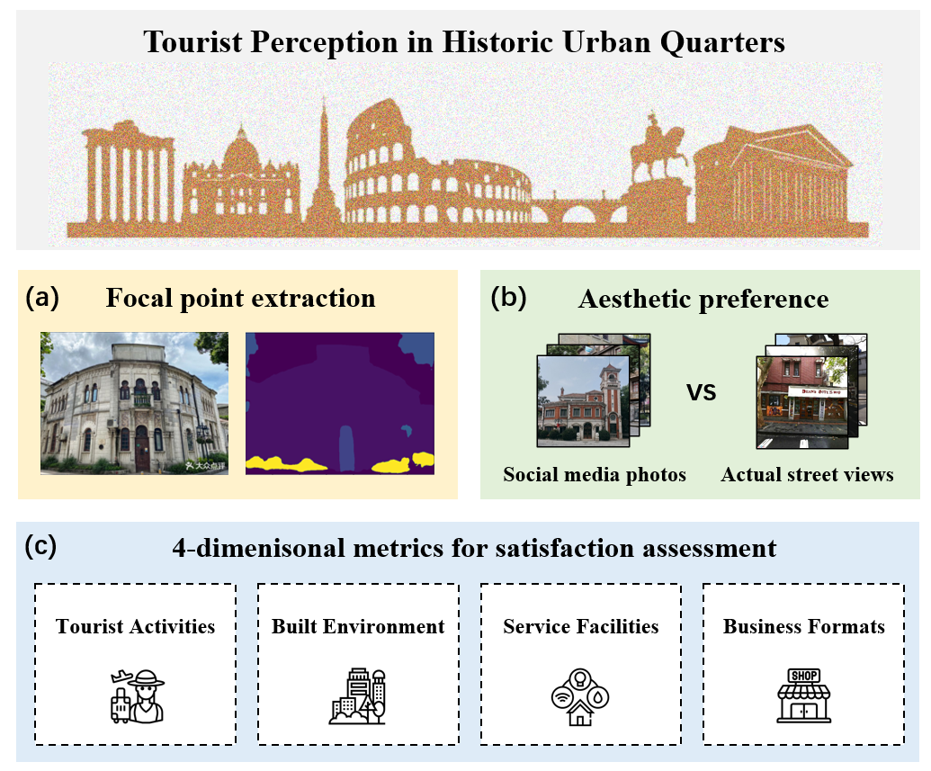
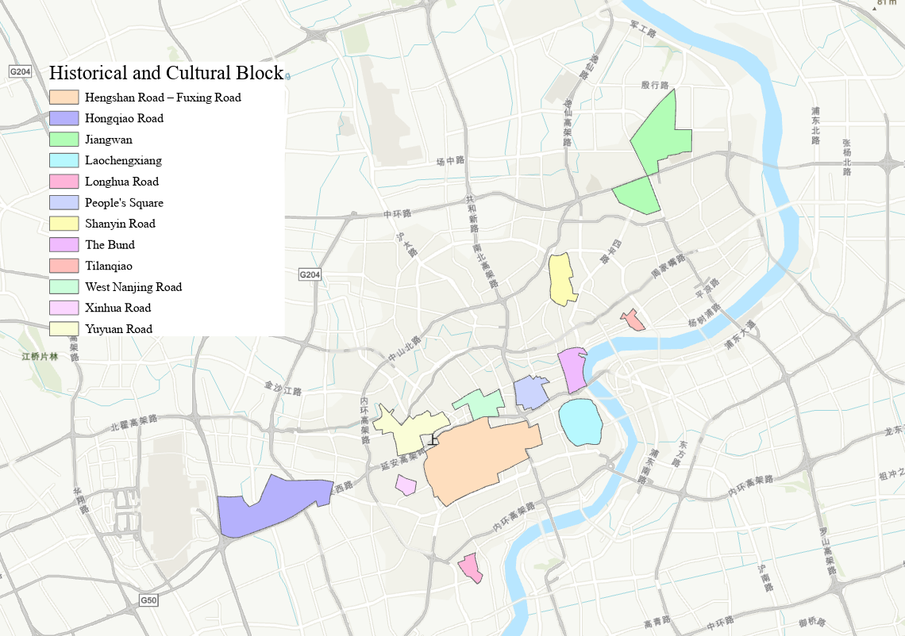
2、Methodology
Existing studies rarely offer an integrated approach that combines image analysis, color aesthetics, and sentiment mining—especially in the context of historic urban quarters.
(a) Semantic segmentation is used to identify the visual focus areas from tourist photos
(b) A comparative analysis of dominant colors and composition between social media photos and actual street views reveals tourists’ aesthetic expectations
(c) Tourist satisfaction is evaluated across four dimensions: Tourist Activities, Built Environment, Service Facilities, and Business Formats
Our study addresses the gap by proposing a multidimensional AI-powered framework to analyze tourist perception, using 12 historic and culture blocks in central Shanghai as a case study.

Slide 9
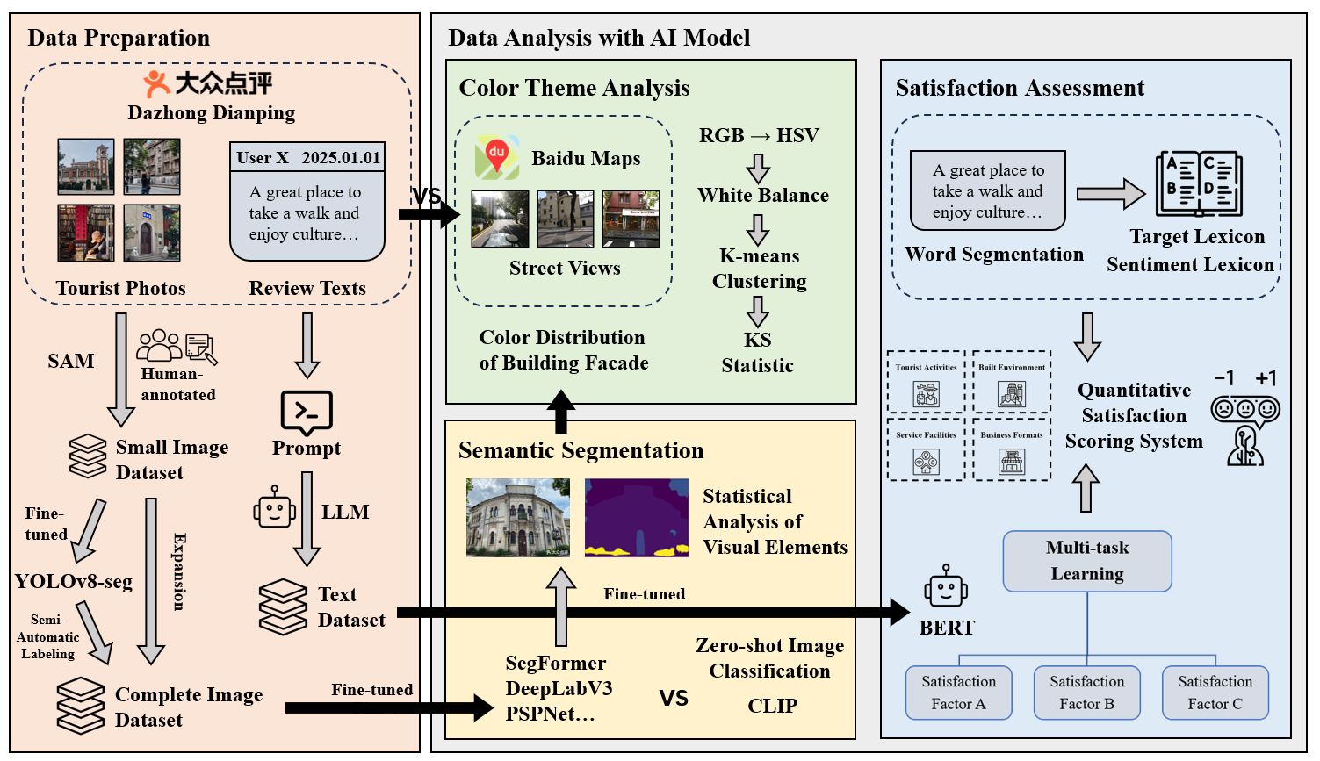
2、Methodology

Slide 10
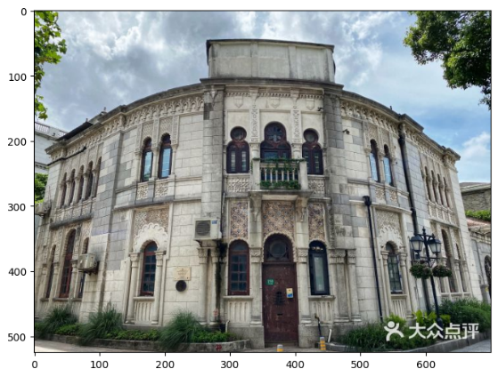
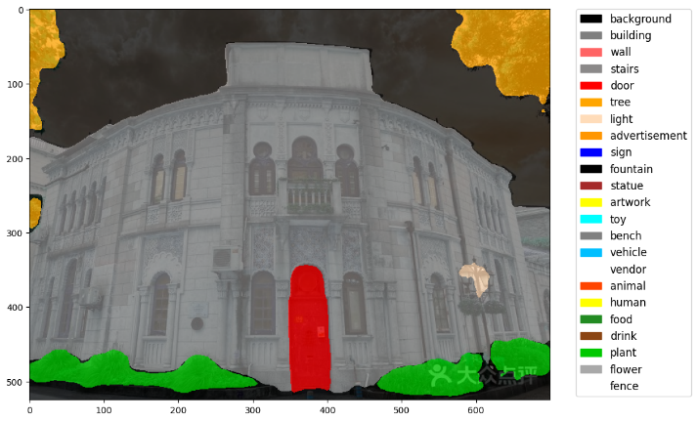
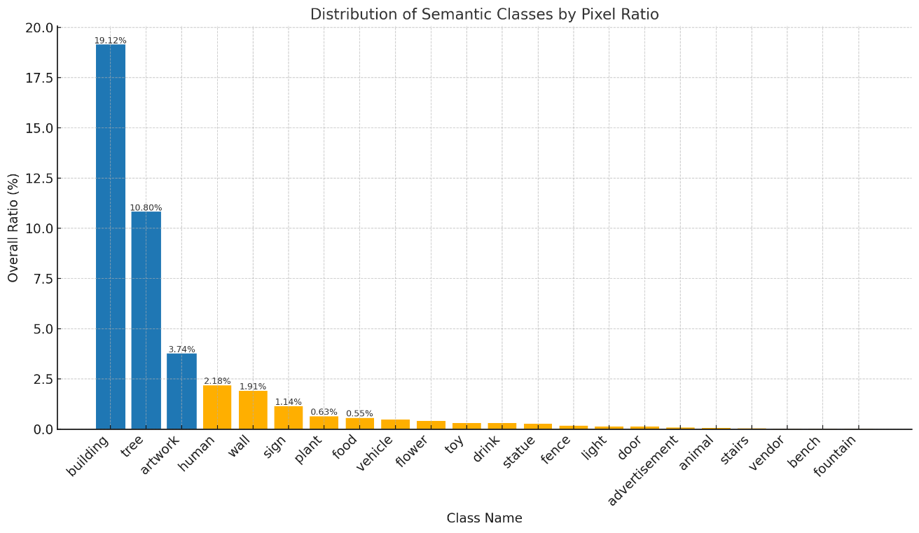
3、Results
We calculated the total number of pixels and corresponding proportions for each semantic class.
Overall, the distribution aligns with intuitive understanding and reflects the composition of real-world streetscapes in historic quarters.
Buildings account for the largest share, comprising 19.12% of total pixels, followed by trees at 10.80% and artworks at 3.74%.
Other relatively prominent categories include humans, walls, and signs, all exceeding 1%.
Elements such as advertisements, street vendors, and fountains occupy minimal proportions, indicating their lower frequency in typical street scenes.

Slide 11
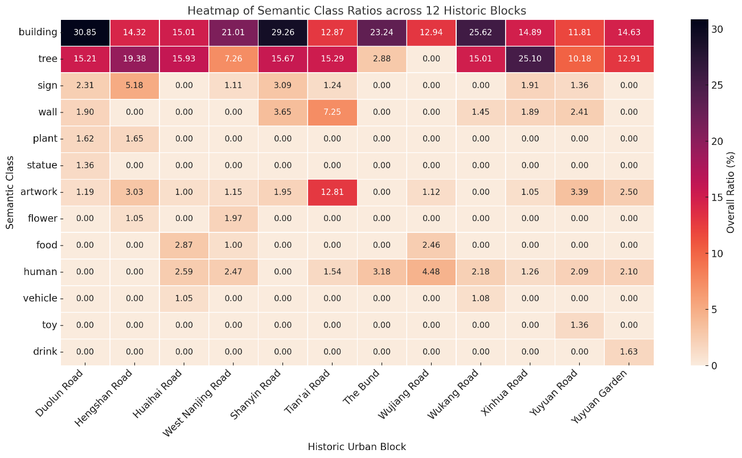
3、Results
In leisure-oriented commercial areas, greenery and historic buildings dominate the visual composition.
Heatmap of semantic class ratios across 12 historic urban quarters
Hengshan Road, Tian’ai Road, and Xinhua Road
In bustling commercial areas, vehicles appear more frequently, reflecting the concentration of traffic in these zones.
Huaihai Road and Wukang Road
Distinct patterns of urban use → human > tree
the Bund: waterfront cityscapes
Wujiang Road: food culture
The statistical results align closely with the spatial characteristics of the quarters.
Strong artistic character → artwork > 3%
Tian’ai Road: the graffiti wall
Yuyuan Road, Hengshan Road: public art installations

Slide 12
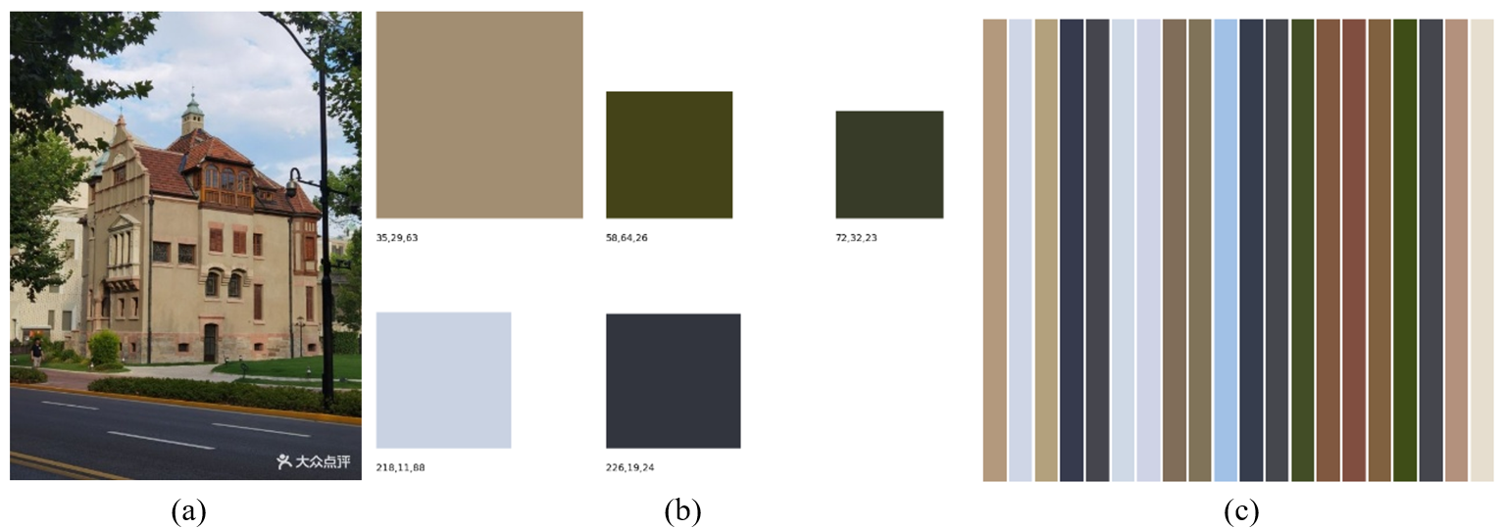
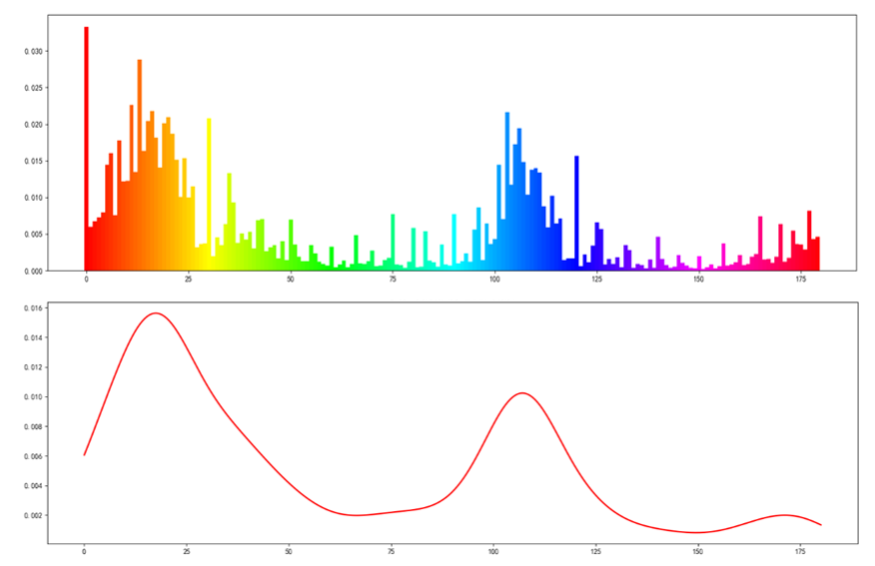
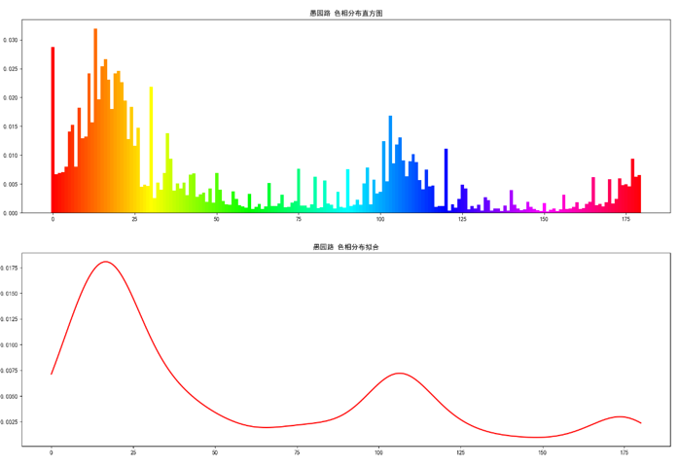
3、Results
For each tourist photo,
Top 5 dominant colors using K-means clustering
Top 20 dominant colors using Chinese color system
For each urban quarter,
we analyzed spatial patterns of color composition by examining the distribution of hue (H) values.
Both the aggregate and quarter-level distributions show consistent bimodal patterns, with peaks around the orange-red (H ≈ 0–30) and blue-violet (H ≈ 100–120) ranges, indicating that these tones are particularly prevalent in the urban landscape.
Overall
Yuyuan Road

Slide 13
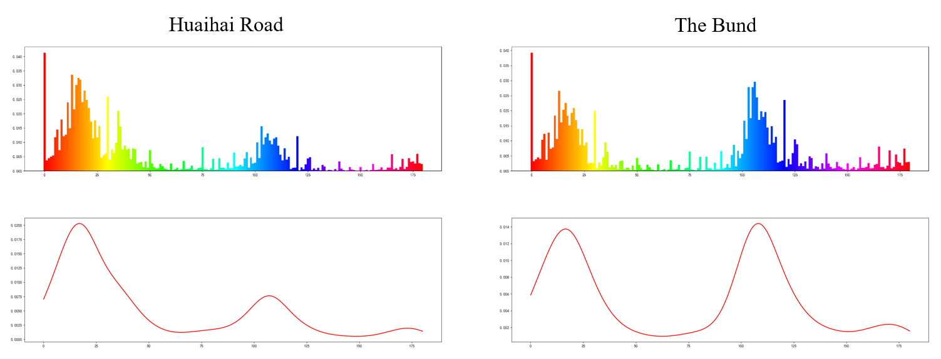

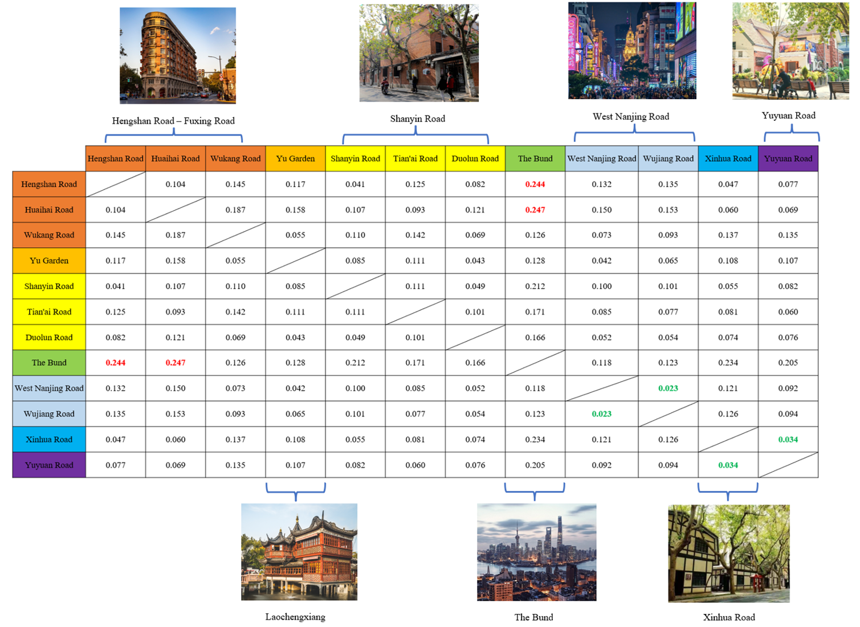
3、Results
Color Distribution & Inter-Quarter Differences
Metric: Kolmogorov–Smirnov (KS) statistic
Smaller KS value = higher similarity in hue distribution
Low Similarity Quarters:
Fuxing Rd vs. the Bund: KS = 0.244
Huaihai Rd vs. the Bund: KS = 0.247
Functional contrast: indoor spaces (warm hues) vs. outdoor waterfront (cool hues)
High Similarity Quarters:
Wujiang Rd vs. West Nanjing Rd: KS = 0.023
areas are located less than 50 meters apart
Xinhua Rd vs. Yuyuan Rd : KS = 0.034
similar artistic/commercial functions → shared color profiles
Citywide Trend:
Dominant tones = beige & ochre (米黄&土黄）
Indicates a visually coherent architectural palette across historic quarters

Slide 14
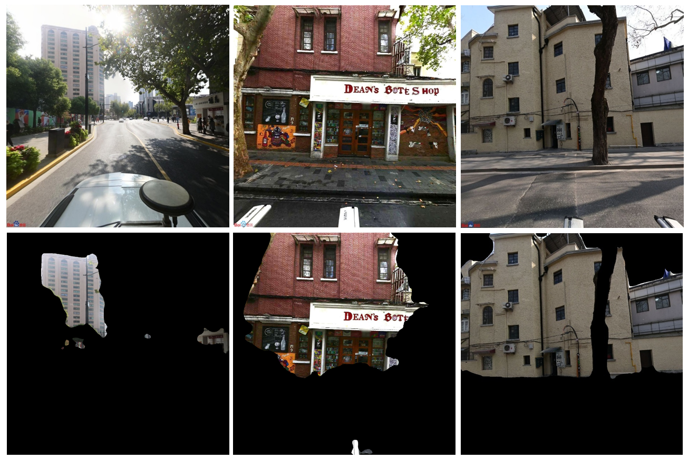
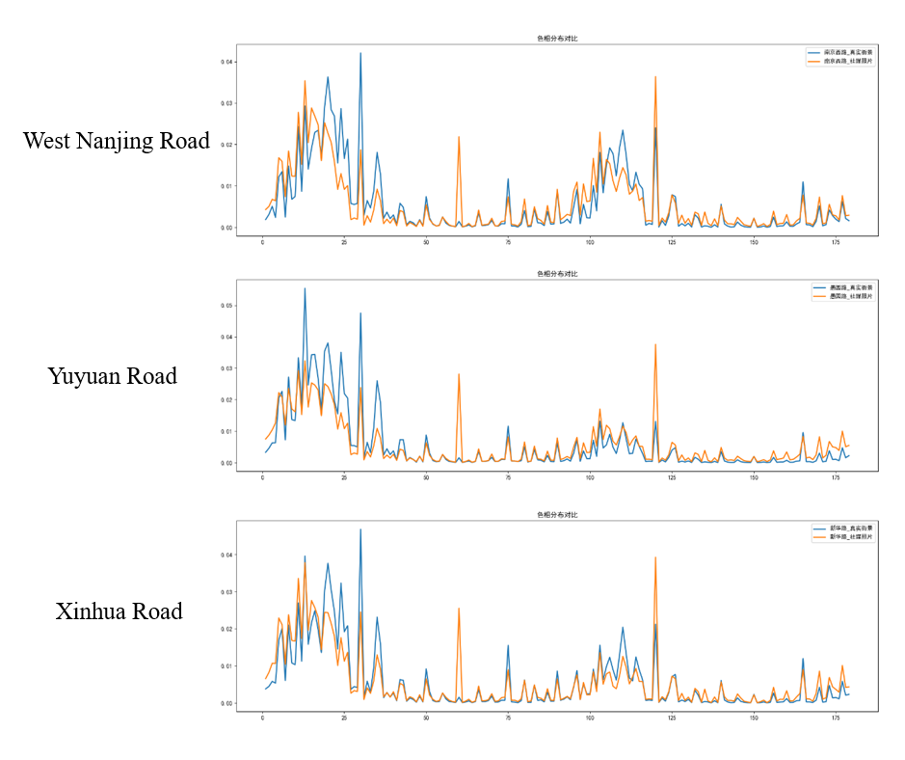
3、Results
Social Media vs. Street View: Façade Color Comparison
How to explain the hue shift?
Technical factors (insufficient explanation):
online compression / color space conversion
environmental conditions (lighting, weather, time of day)
reflections (glass, water)
Key interpretation:
aesthetic preferences drive the shift
result: systematic bias in social media color profiles
Applied fine-tuned semantic segmentation model to isolate building façades
Tourists tend to:
photograph buildings they find visually appealing
use compositions, angles, and lighting that they personally consider attractive
enhance images with filters
Such perspectives implicitly reveal their preferences for color distribution.
Social media photos → more cool tones (green, blue: H = 60, 120)
Street view images → more warm tones (orange-yellow: H = 10–30)

Slide 15
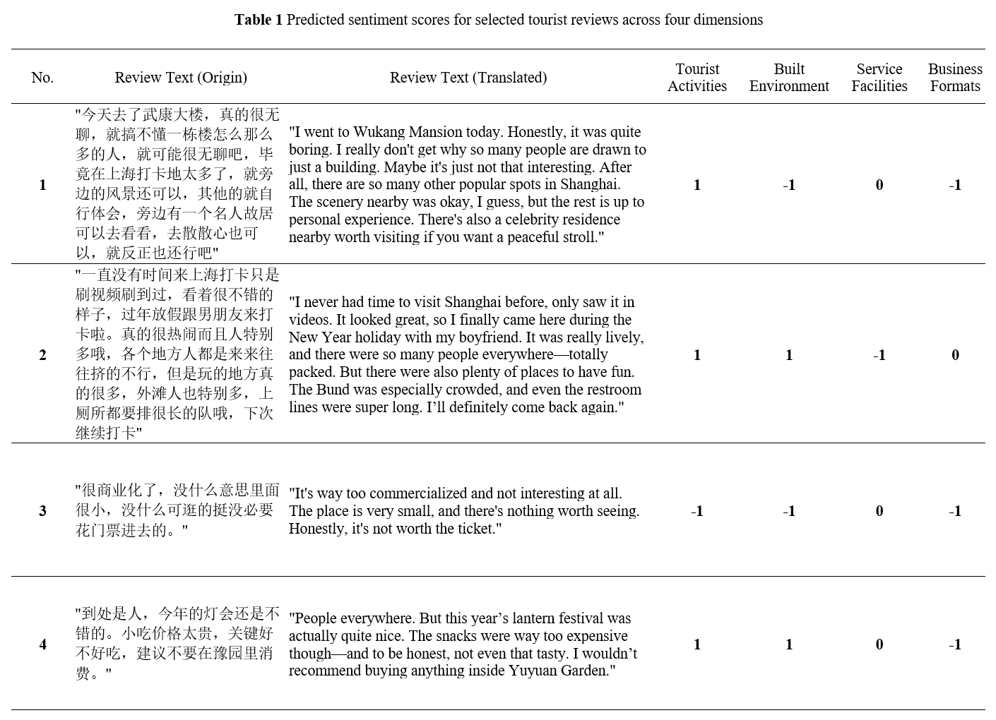
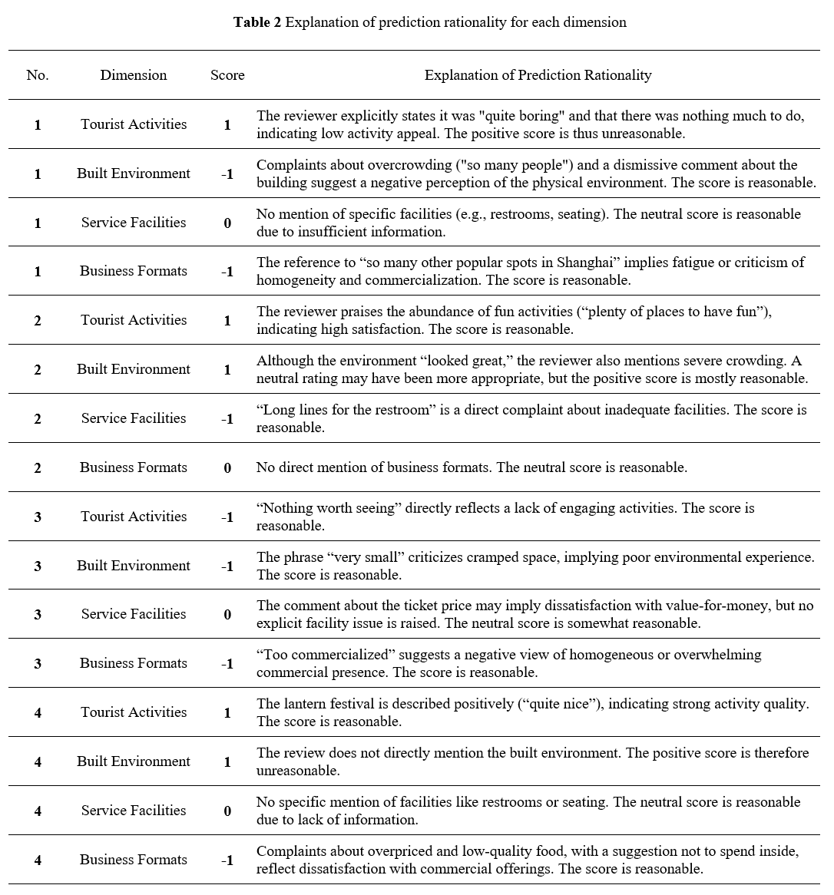
3、Results
To evaluate the performance of our multi-task BERT, we selected several representative tourist reviews.
Overall, the model demonstrates strong capability in capturing sentiment across four dimensions. The predictions are largely consistent with human interpretation.
This study does not focus on technical innovation; therefore, no comparison experiments or ablation studies are conducted.

Slide 16
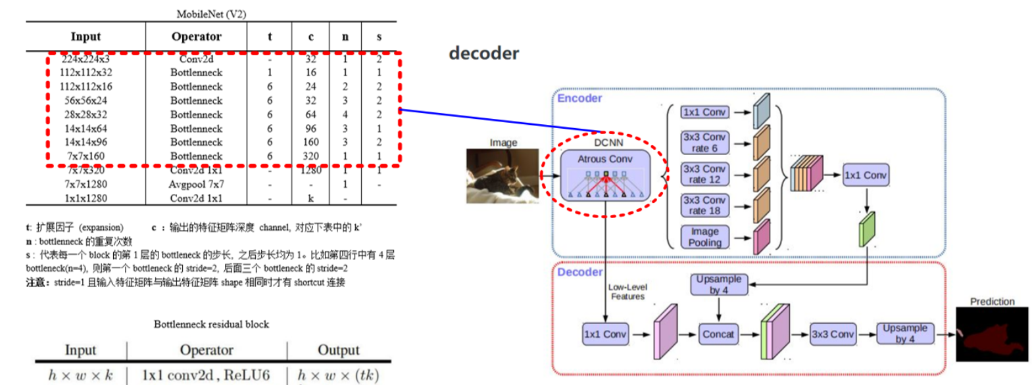
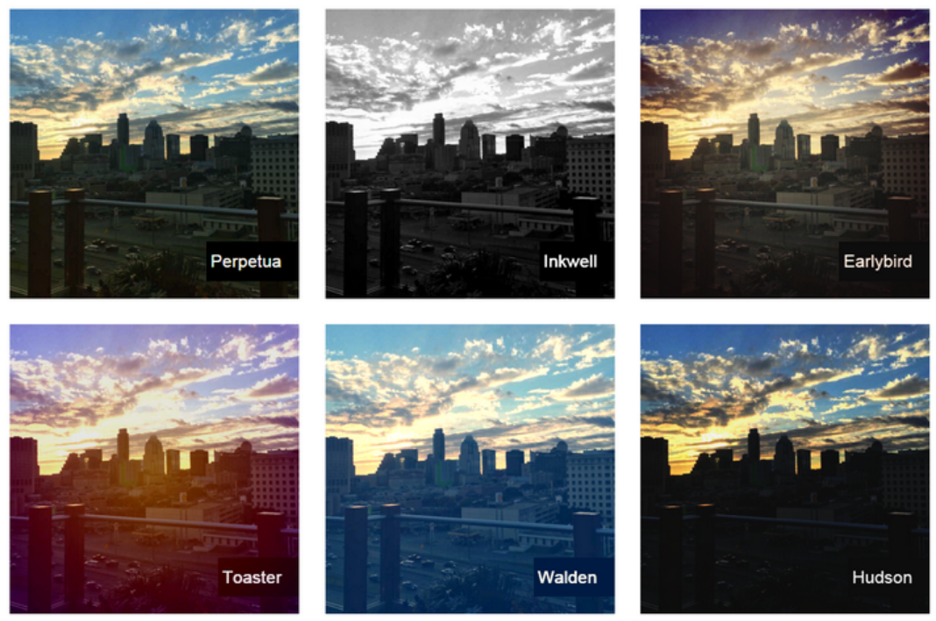

4、Discussion
Image & Language Model Performance
Semantic Segmentation:
Current model: DeepLabV3 + MobileNetV2
Pros: lightweight, fast
Limitation: limited performance in complex scenes
Future plans:
Evaluate more SOTA models
Apply advanced data augmentation
Satisfaction Prediction:
Currently based on text reviews only
Lacks connection to physical urban features
Future integration:
Visual attributes (style, cleanliness, greenery)
Quantifiable indicators (crowd density)
Multimodal fusion for better perception modeling
Color Analysis & Social Media Bias
“Filter Effect”:
Social media images may distort real-world colors
Risks misinterpretation in landscape or planning analysis
Future directions:
Study cross-platform / cross-cultural color shifts
Use deep learning method to calibrate visual data against street view
Practical Implications:
Inform color design guidelines for historic quarters renewal
Enhance streetscape coherence and visual comfort
Support visual planning for:
Public art placement
Commercial atmosphere enhancement

Slide 17
5、Conclusion
The study proposes a multidimensional AI-powered framework to decode tourist perceptions of historic urban quarters. The main contributions are as follows:
We propose the first framework for historic urban quarters that jointly analyzes visual content, color preferences, and emotional responses to reveal how tourists cognitively and emotionally engage with these environments.
A semantic segmentation model is developed to detect focal attention areas in historic urban context, and a multi-task BERT model is developed to assess satisfaction across four perceptual dimensions based on textual reviews
Color distribution is introduced as an abstract representation of aesthetic preference, and a novel comparative analysis is conducted between tourists photos and actual street views to uncover potential mismatches, offering new insight into unmet visual expectations.

Slide 18
Thank you!

